Slide 1


C# for Beginners
Module 2: Object Oriented Programming (OOP) in C#
Kyriacos Kyriacou
kyriakos.kyriakou@studentpartner.com



Slide 2
About
Kyriacos Kyriacou
Microsoft Student Partner
Computer Science Student
Certificate of Attendance (In the end)
+ Surprise for those who attend all 3

Slide 3
Roadmap (Today)
Object-oriented theory
Classes
Constructors
Methods
Fields & Properties
Access Modifiers
Instantiation
Inheritance & Polymorphism
Abstract Classes
Interfaces
Casting

Slide 4
What is OOP?
Programming Paradigm Based on Objects
Object:
Contain Data (Field / Attribute)
Contain Code (Procedure / Method)

Slide 5

Object (Suzuki Swift)
Attributes
Methods
Fuel
Max Speed
Horse Power
Brand
StartEngine()
Drive()
AddFuel()

Slide 6
Class
Blueprint or template for creating objects
Characteristics
Fields & Properties
Methods
Constructors (Initializer)

Slide 7


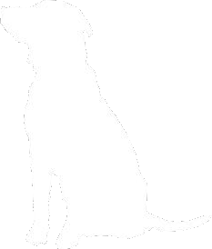



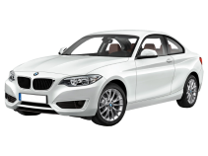
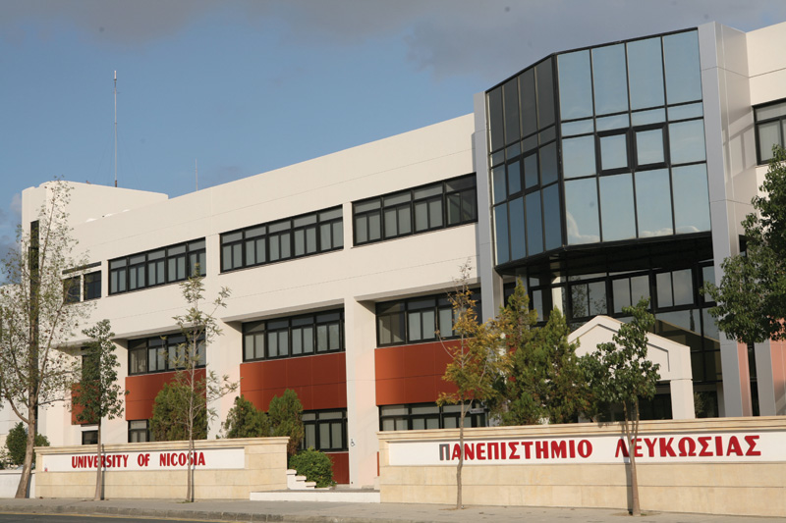
Class → Instance
Class
Dog
Car
Building
Instance
Lucy, Max
Your Car
Main Building

Slide 8
Constructor & Behavior
Constructor
Class initializer (set default values)
Methods
Define behaviors

Slide 9
Properties
Field
Data storage
Should be kept private (almost always)
Property
Used to expose fields
Return result of calculation (without relying on fields)
Can be used as field gatekeeper (e.g. validation)

Slide 10
Access Modifiers
Access Modifier
Private: Within class only
Protected: Within class and derived classes (seen later)
Internal: Within assembly only (read same project)
Public: The world is your oyster! (accessible everywhere)

Slide 11
DEMO

Slide 12
What if…
Cat
Properties Name Legs WhiskerColor ———————— Methods Meow() Feed()
Dog
Properties Name Legs ———————— Methods Bark() Feed()
Bird
Properties Name Legs Wings ———————— Methods Tweet() Feed() Fly()
How would you create these classes?

Slide 13
They have some things in common
Cat
Properties Name Legs WhiskerColor ———————— Methods Meow() Feed()
Dog
Properties Name Legs ———————— Methods Bark() Feed()
Bird
Properties Name Legs Wings ———————— Methods Tweet() Feed() Fly()

Slide 14
Inheritance
Dog, Cat, and Bird Example
All of them are Animals
Animal can be “Base Class/Category”

Slide 15
Inheritance
Provides base fields + methods (behaviors)
Great for code reuse
All classes & types in C# derive from Object
Can only inherit from one class

Slide 16
Animal
Properties Name Legs ———————— Methods Feed()
Cat
Properties WhiskerColor ———————— Methods Meow()
Dog
Properties ———————— Methods Bark()
Bird
Properties Wings ———————— Methods Tweet()

Slide 17
DEMO

Slide 18
Abstraction
In Animal Example
We don’t need to instantiate the Animal class
Animal Class is an abstraction of their base class

Slide 19
Abstract
Abstract Class
Cannot instantiate
Often used to define base class
Useful in polymorphism (Later in example)
Abstract Methods

Slide 20
Abstract Methods
NOT to be confused with Abstract Class
Signature / Prototype / Method Definition

Slide 21
Overriding
Allows for new implementation of a function that is defined in the base class
Enables polymorphism

Slide 22
DEMO

Slide 23
Interface
Like an abstract class, but with NO DEFAULT DEFINITION
Class can implement multiple interfaces

Slide 24
Class vs Abstract Class vs Interface
 | Instantiation | Implementation | Declaration*
Class | ✓ | ✓ | ✓
Abstract Class |  | ✓ | ✓
Interface |  |  | ✓
* Declaration / Prototype / Signature:
Declaring empty field* / property / method without implementation

Slide 25
DEMO

Slide 26

Object in Memory
Dog
Fields Name = “Jack” Legs = 4 ———————— Methods Bark() Feed()
Dog
dog1
Dog
dog2

Slide 27

Object in Memory (cont’d)
Dog
Fields Name = “Jack” Legs = 4 ———————— Methods Bark() Feed()
Dog
dog1
Dog
dog2

Slide 28

Upcasting
object
…
Dog
Fields Name = “Jack” Legs = 4 ———————— Methods Bark() Feed()
Animal
Properties Name Legs —————— Methods Feed()
object
obj
Animal
animal
Dog
Methods Bark()
Dog
dog1
Dog
dog2

Slide 29
DEMO

Slide 30
Summary
Classes
Constructors
Methods
Fields & Properties
Access Modifiers
Objects (Instantiated classes)
Inheritance & Polymorphism
Abstract Classes
Interfaces
Casting

Slide 31
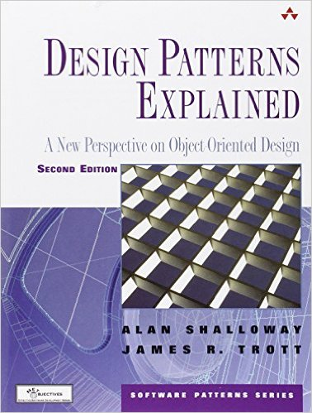
Recommended Reading
Design Patterns Explained (Click Here)
Object Oriented Design
Reusable solutions for common problems
Template on how to solve a problem
ISBN-13: 978-0321247148
Must read for serious programmers

Slide 32

Assignment (Optional)
V 2.0
Parking Program (V 2.0)
Expand the parking program described in module one based on the following:
Create an abstract class Vehicle that would hold common properties and methods for different types of vehicles.

Slide 33
Assignment (Optional)
Derive different types of vehicles as class from Vehicle (e.g. Car, Bike, Truck, etc.)
On the main menu, when adding a new vehicle, ask user for the type of their vehicle. Based on the type, ask for some information regarding the vehicle.
Hint: use a method GetDetail() in the Vehicle Class, and in each derived class, define it based on the fields relevant to the type.

Slide 34
Assignment (Optional)
When adding a new car, make sure the car number does not exist before adding it to the list.
When removing a car, ask for a number and remove it, if it exists
Add new option that would allow user to search for a vehicle by its number. If it exists, display its information.
Hint: Override ToString() method for each derived class to show relevant information

Slide 35
Thank you for your time. Any Questions?

